Slide 1
Developing ChatBot 3-1 Git workflow
Refresh-Foods Inc.
Yestin Yehoon Lee

Slide 2
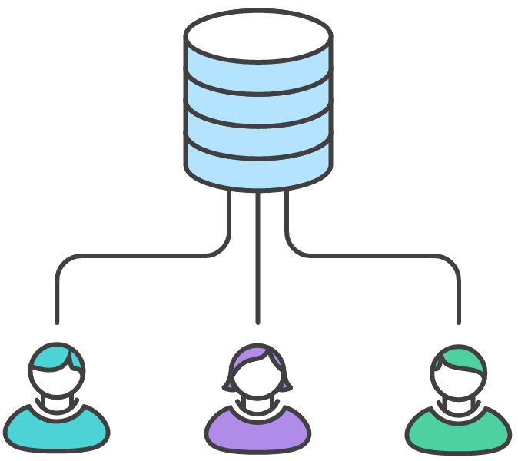

Co-work
Group project
Co-editing
Google Docs.

Slide 3
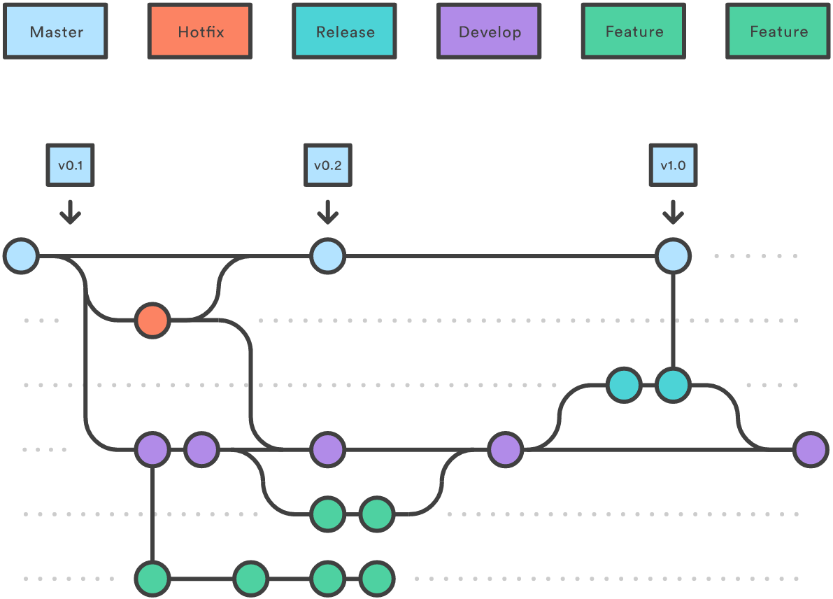
GitFlow Workflow
Master
Develop
Hotfix
Feature
Notes:
https://stackoverflow.com/documentation/git/1276/analyzing-types-of-workflows#t=201707110022243576162
The idea of this one is to have separate branches reserved for specific parts in development:
master branch is always the most recent production code. Experimental code does not belong here.
develop branch contains all of the latest development. These developmental changes can be pretty much anything, but larger features are reserved for their own branches. Code here is always worked on and merged into release before release / deployment.
hotfix branches are for minor bug fixes, which cannot wait until the next release. hotfix branches come off of master and are merged back into both master and develop.
release branches are used to release new development from develop to master. Any last minute changes, such as bumping version numbers, are done in the release branch, and then are merged back into master and develop. When deploying a new version, master should be tagged with the current version number (e.g. using semantic versioning) for future reference and easy rollback.
feature branches are reserved for bigger features. These are specifically developed in designated branches and integrated with develop when finished. Dedicated feature branches help to separate development and to be able to deploy done features independently from each other.

Slide 4
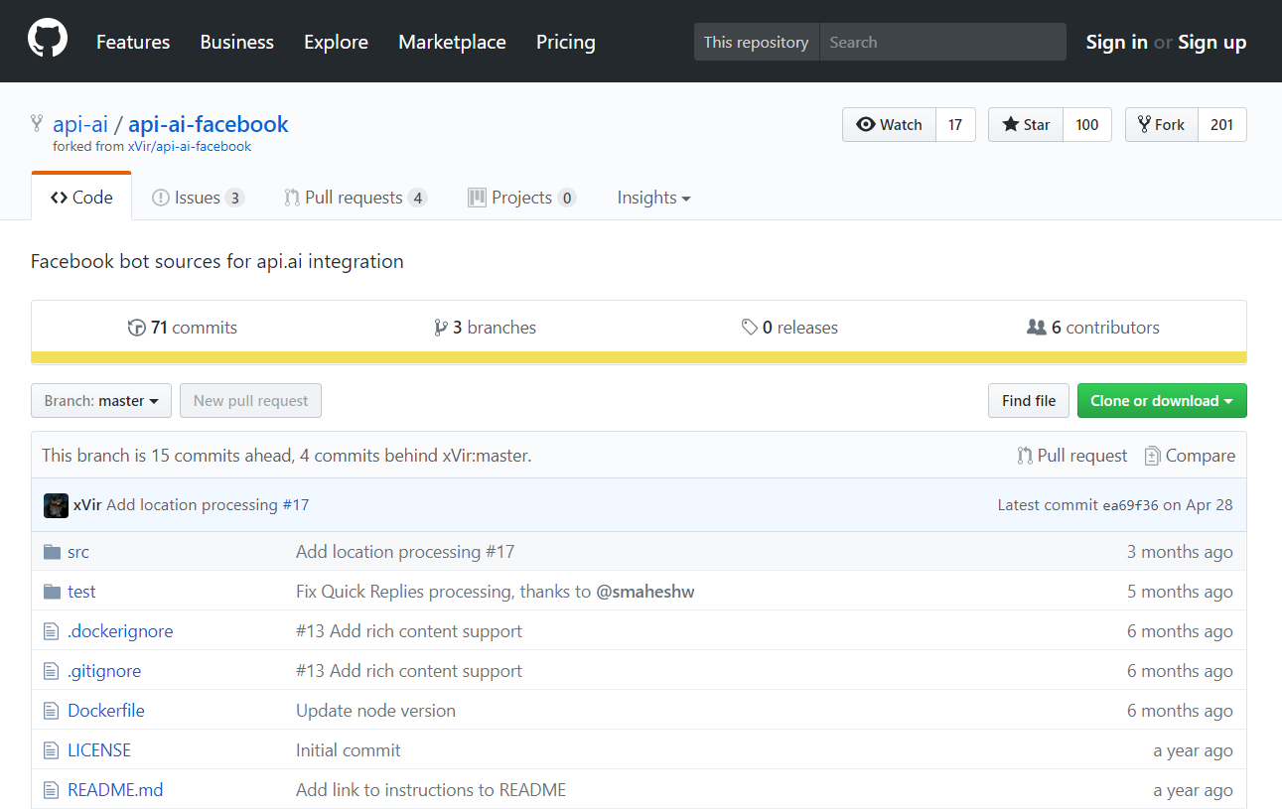
Get Resource from GitHub
Visit GitHub
Download or Clone
No edit code
Copy all files to repository
Notes:
https://github.com/api-ai/api-ai-facebook
What is API? (Application Program Interface)
Only using the interface of program made by some other developers.
http://www.webopedia.com/TERM/A/API.html

